Slide 1
NATIONAL MEALS
Axborot tizimlari va texnalogiyalari (ATT o’zbek gurux)
Yaxshiboyev Muhammad

Slide 2
plan
Vocabulary
Collacation and phrasal verbs
Uzbek national meals
YAXSHIBOYEV MUHAMMAD

Slide 3
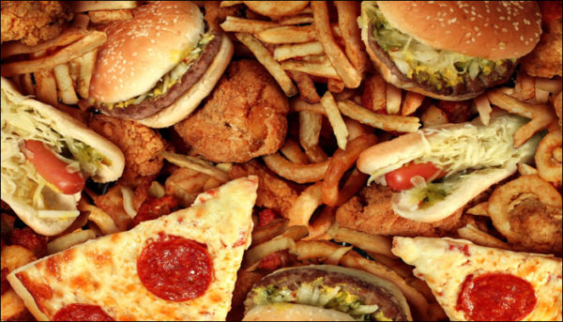
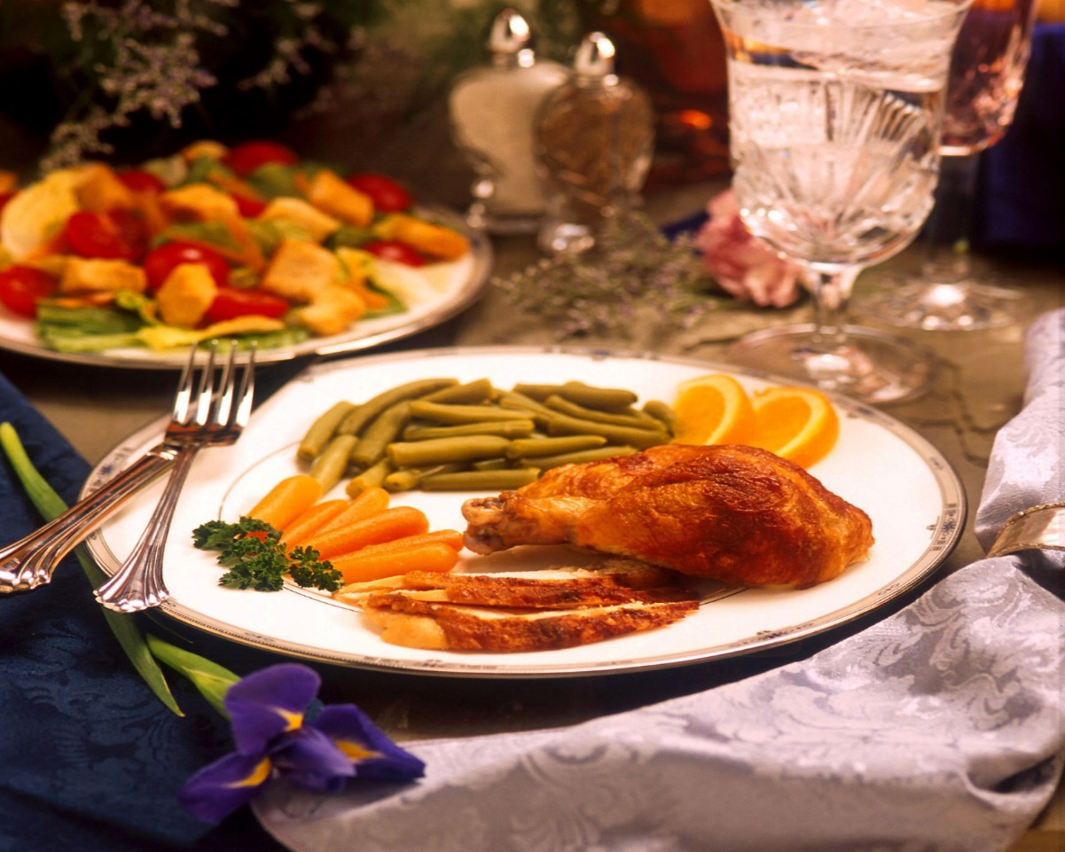
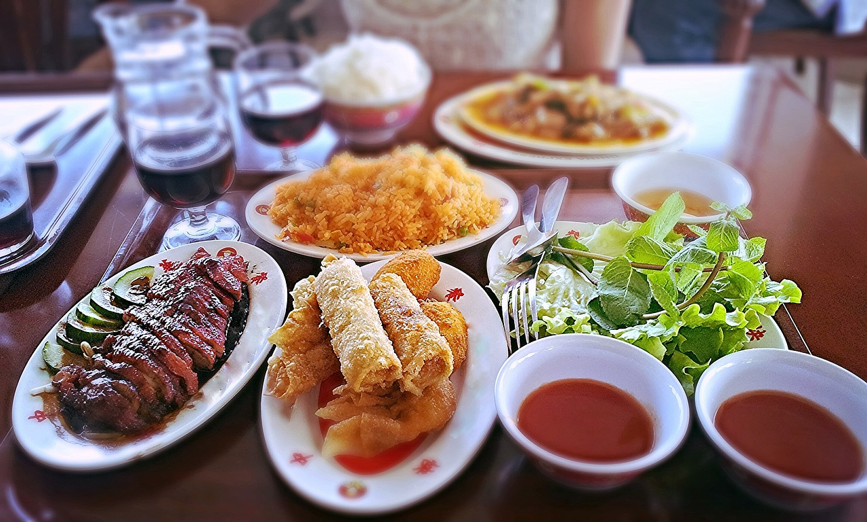
National meals - is a culinary dish that is strongly associated with a particular country

Slide 4
EXERCISES
What is the man’s job? What food does he cook? Where does he work?
2 1.33 Listen to a travel writer for National Geographic magazine. Answer the questions. 1 Why does he say he has a great job? 2 Why does he really love travelling? 3 Where does he always go when he arrives in a new city? 4 His favourite place in Bangkok is Chinatown. Why? 5 What is his favourite dish?
3 1.33 Complete the sentences with these food verbs. Then listen again and check. cook eat make serve smell taste 1 All the street chefs make the food by hand. 2 Then they it on a real fire. 3 So when you walk up the street, you can the food in the distance. 4 The chefs the noodles with a hot sauce. 5 They delicious. 6 I can them at any time of day – for breakfast, lunch or dinner
YAXSHIBOYEV MUHAMMAD

Slide 5
VOCABULARY
^Overcooked Cooked beyond the optimal cooking ᴛɪᴍᴇ
^ The pasta was overcooked and too ꜱᴏꜰᴛ
^Fresh Food materials or products that have been recently ᴩʀᴇᴩᴀʀᴇᴅ
^ The marinara at that outlet is prepared fresh every ᴅᴀy
^Raw Not cooked properly/at all The vegetables were raw and hard to ᴄʜᴇᴡ
^Stale/Rotten Spoiled and past its optimal usage time
The whole room smells like rotten ᴇɢɢꜱ
^Unripe Immature food item – not fit for consumption The bananas you bought yesterday were ᴜɴʀɪᴩᴇ
^Off Not tasting as it should The food at last night’s restaurant seemed off to me
YAXSHIBOYEV MUHAMMAD

Slide 6
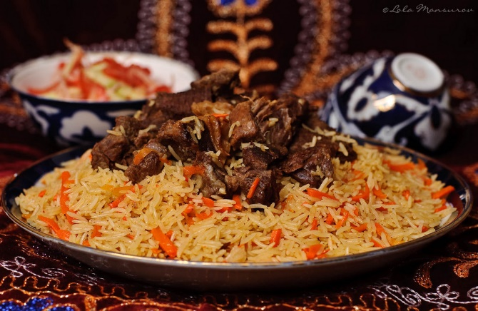
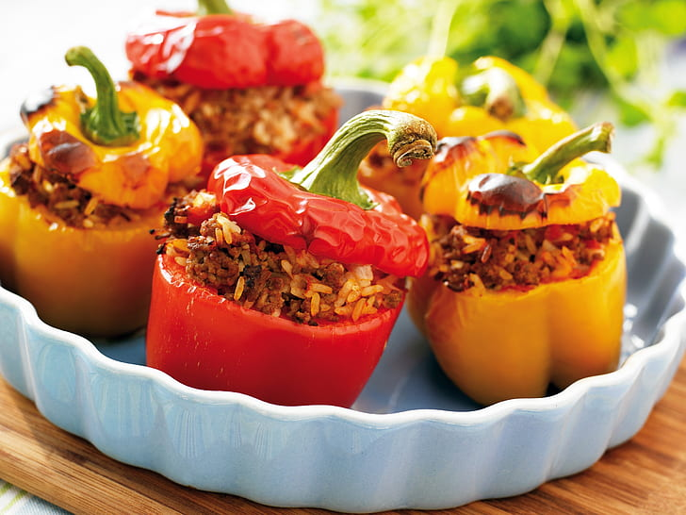
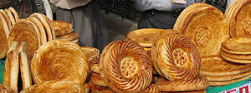
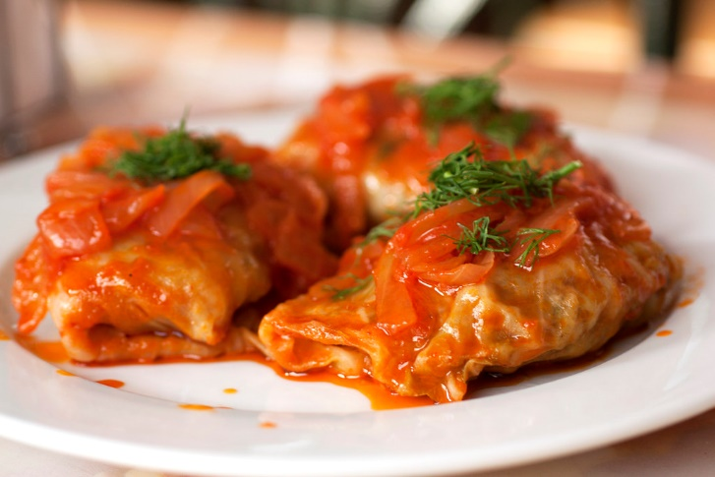
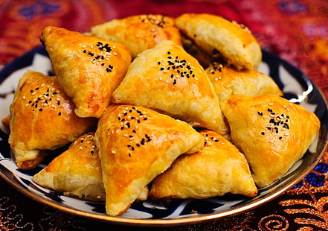
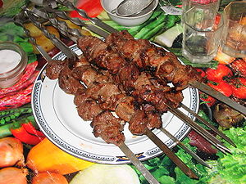
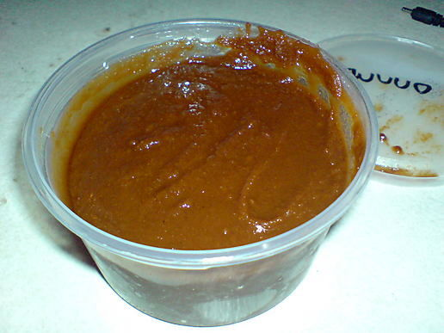
Uzbek national meals

Slide 7
Uzbek national meals
Uzbek food is among the most delicious in the world, for over the centuries it absorbed and adapted the best recipes from neighboring cultures to create a flavorful and satisfying cuisine. A highlight of Uzbek cuisine in comparison with its Central Asian neighbors is that they enjoy not only meat dishes but vegetables and salads too. In fact, Uzbek fruits and vegetables are so good that they are exported to other countries.
This was not always the case, however. Until the 19th century the local diet consisted mostly of meat, dough, milk and cereals. Meat, particularly beef and lamb, remain the basis of the local diet today. Horse meat is also enjoyed as a delicacy, while poultry is less popular. Fish dishes are rather uncommon in this double-landlocked nation. Uzbek food is rich in seasonings which accentuate the flavor of the dishes and leave a pleasant aftertaste.
YAXSHIBOYEV MUHAMMAD

